Slide 1





DAY-3
Data Visualization & EDA

Slide 2



Instructor
From: Prodi Teknik Elektro, Institut Teknologi Bandung
Social Media:
Cynthia Evani
@cynthiaevani
Certification:
Google IT Automation with Python
Google Tensorflow Developer
AWS Certified Cloud Practitioner
Experience:
Machine Learning Student, Bangkit Academy (2021)
Machine Learning Engineer, PT Nomura Research Institute Indonesia (2021 - )
Cynthia Evani
DKI Jakarta

Slide 3
Why data visualization?
first step of analytics work
intuitive understanding of data
helps you identify certain patterns

Slide 4
NumPy

Slide 5
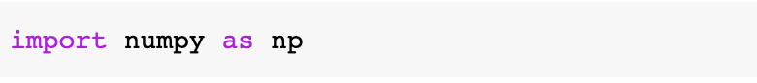
NumPy
A Python library to perform operations on arrays.
Computationally more efficient than list and provides built-in methods.

Slide 6
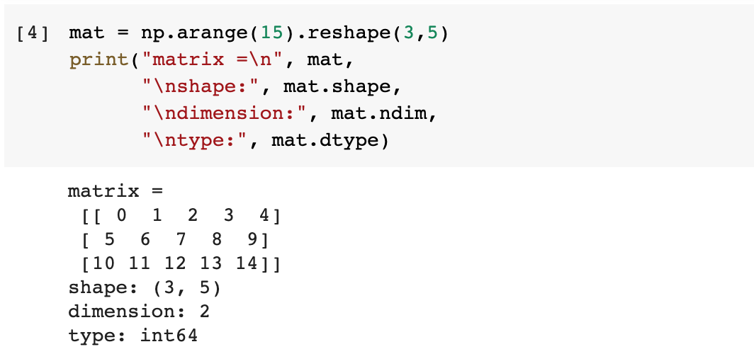
NumPy
Example:

Slide 7
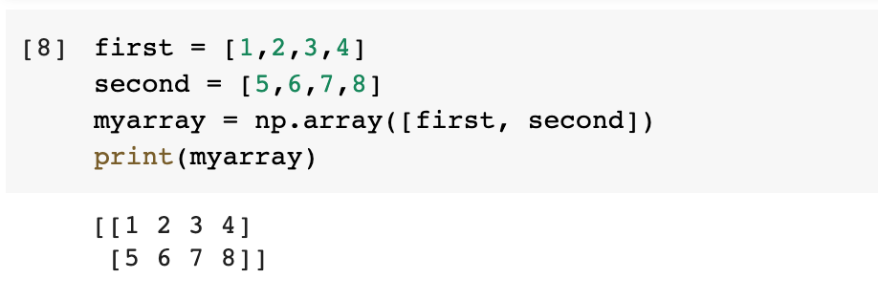
NumPy
Creating an array

Slide 8
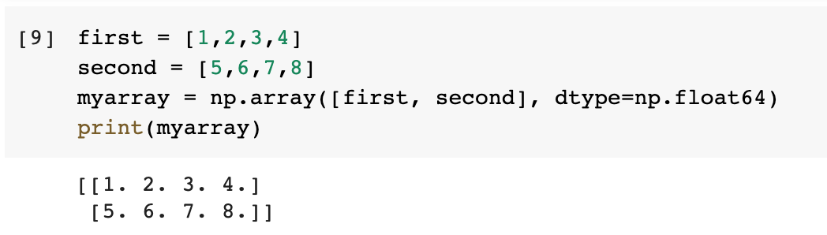
NumPy
Creating an array

Slide 9
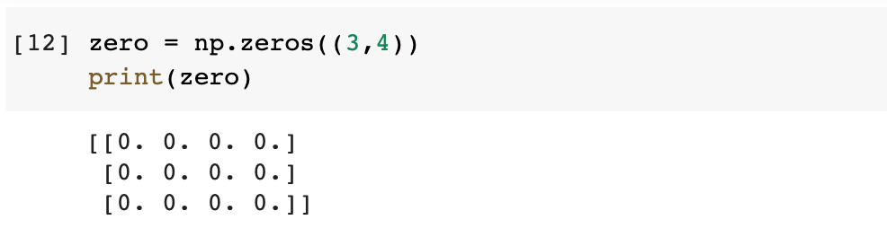
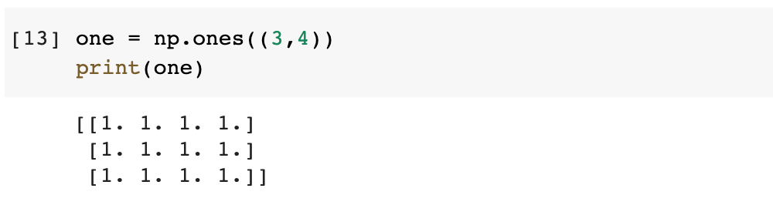
NumPy
Creating an array containing all zeros
Creating an array containing all ones

Slide 10
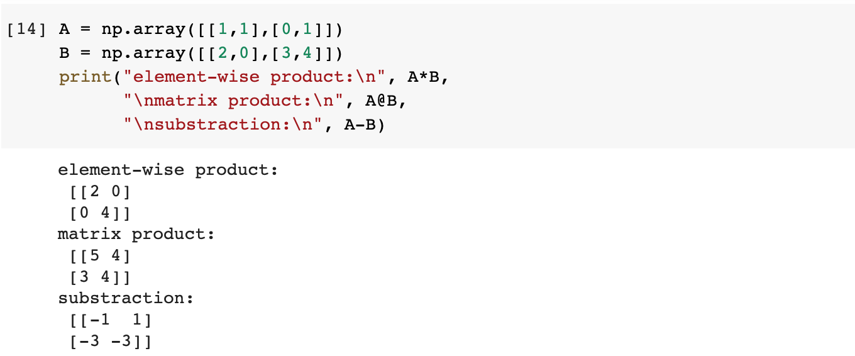
NumPy
Basic operations

Slide 11
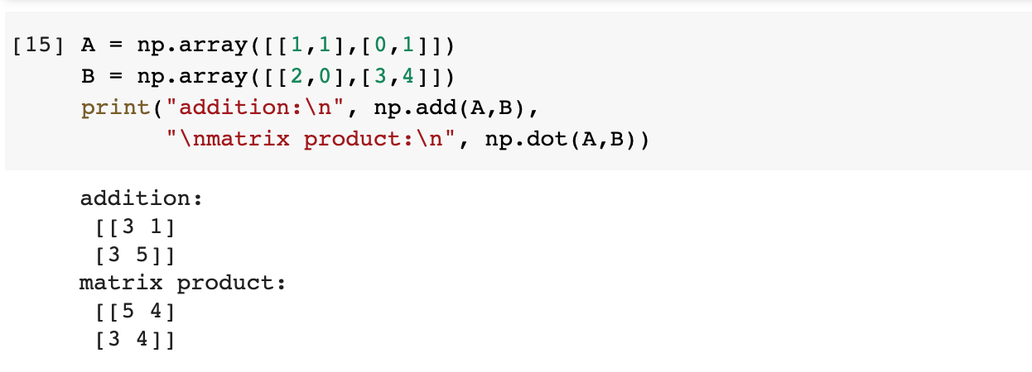
NumPy
Basic operations

Slide 12
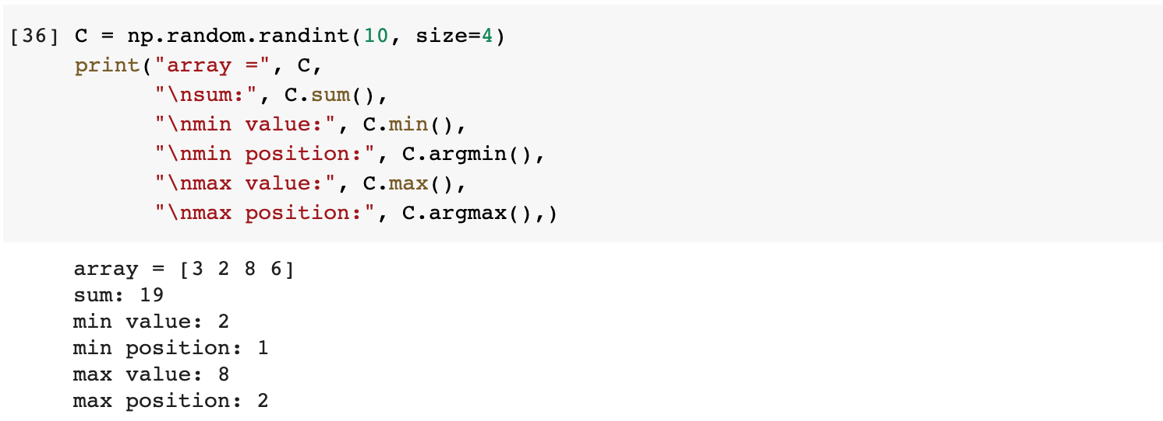
NumPy
Basic operations

Slide 13
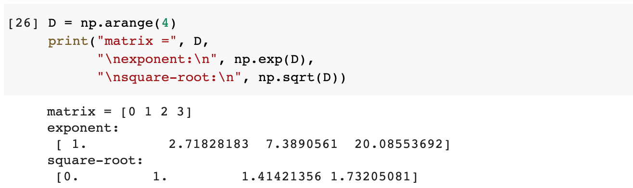
NumPy
Basic operations

Slide 14
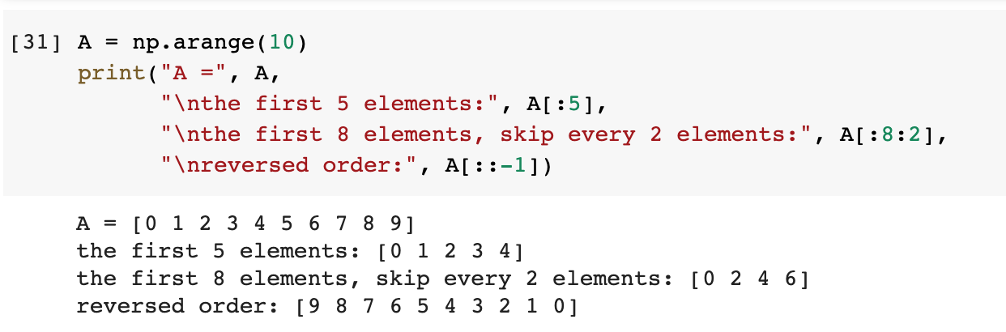
NumPy
Indexing and slicing (one-dimensional array)

Slide 15
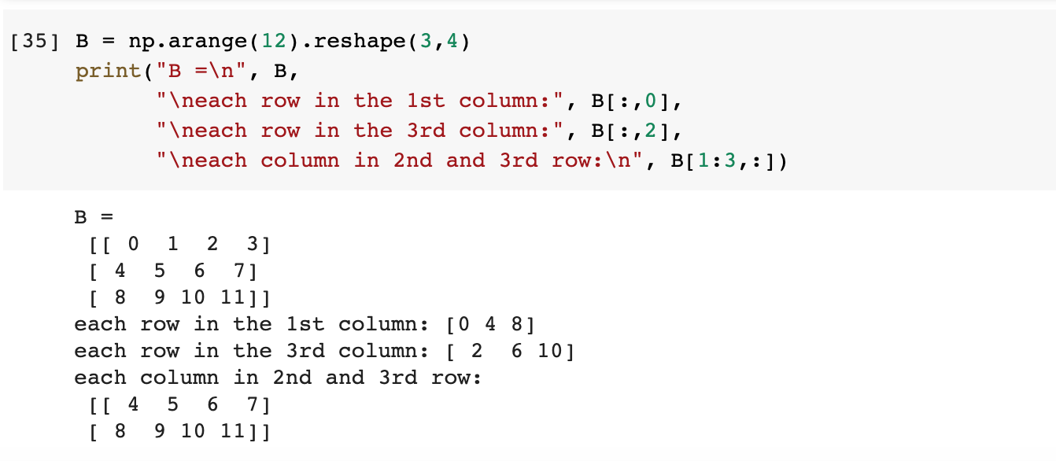
NumPy
Indexing and slicing (multi-dimensional array)

Slide 16
NumPy
Indexing and slicing (multi-dimensional array)

Slide 17
Pandas

Slide 18
Pandas
A Python library that provides data structures and data analysis tools.
Has functions for analyzing, cleaning, exploring, and manipulating data.

Slide 19
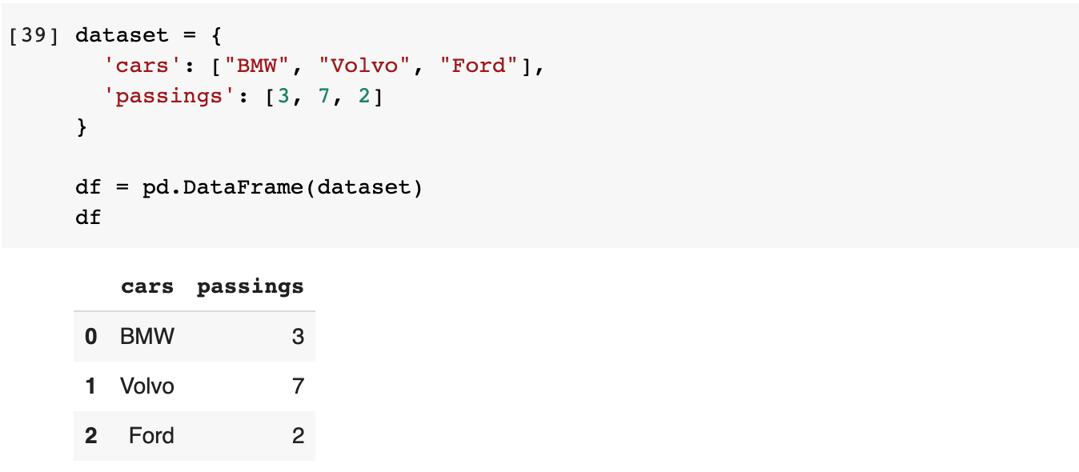
Pandas
Example:

Slide 20
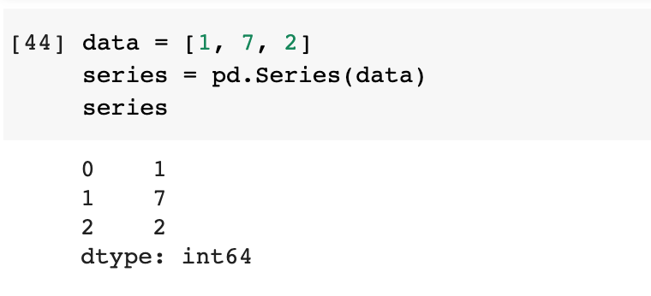
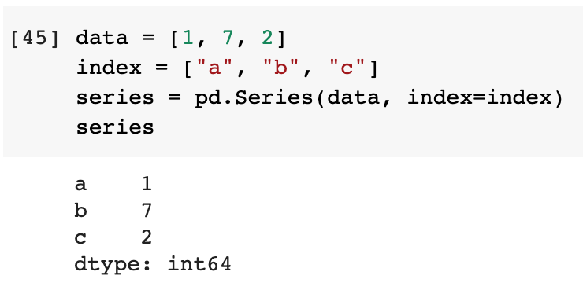
Pandas
Series
One-dimensional array, like a column in a table

Slide 21
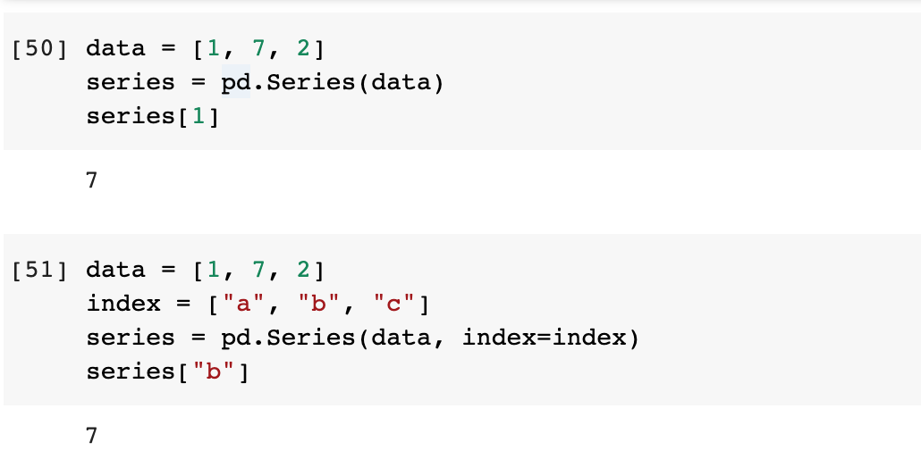
Pandas
Series
Indexing

Slide 22
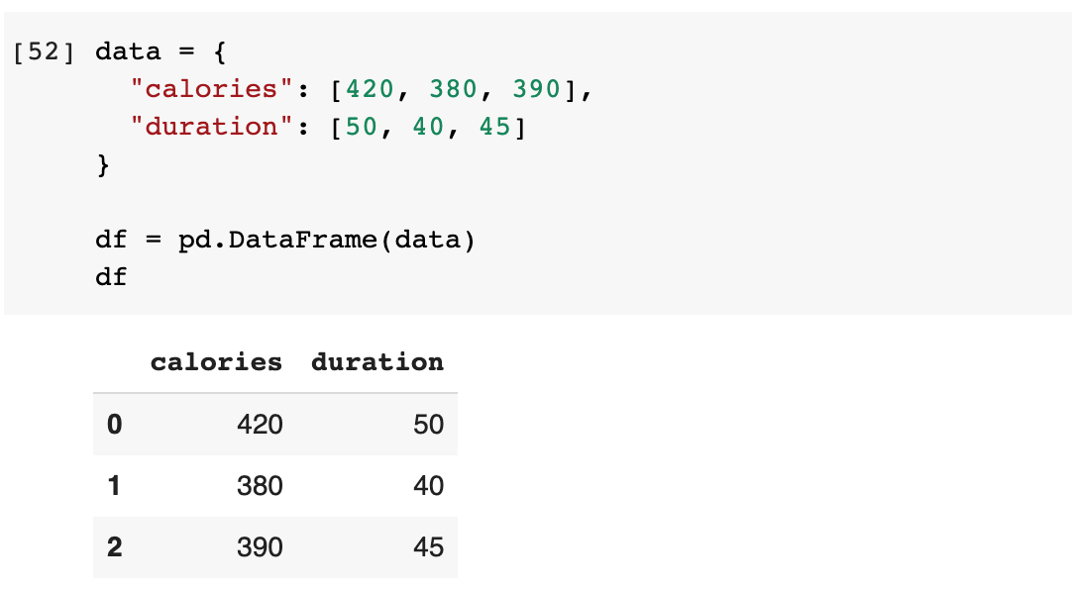
Pandas
DataFrame
2-dimensional array, like a table with columns and rows

Slide 23
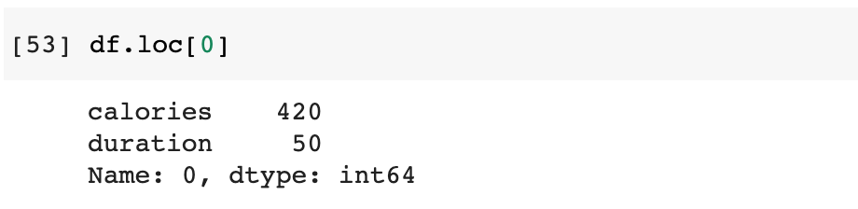
Pandas
DataFrame
Locate row

Slide 24
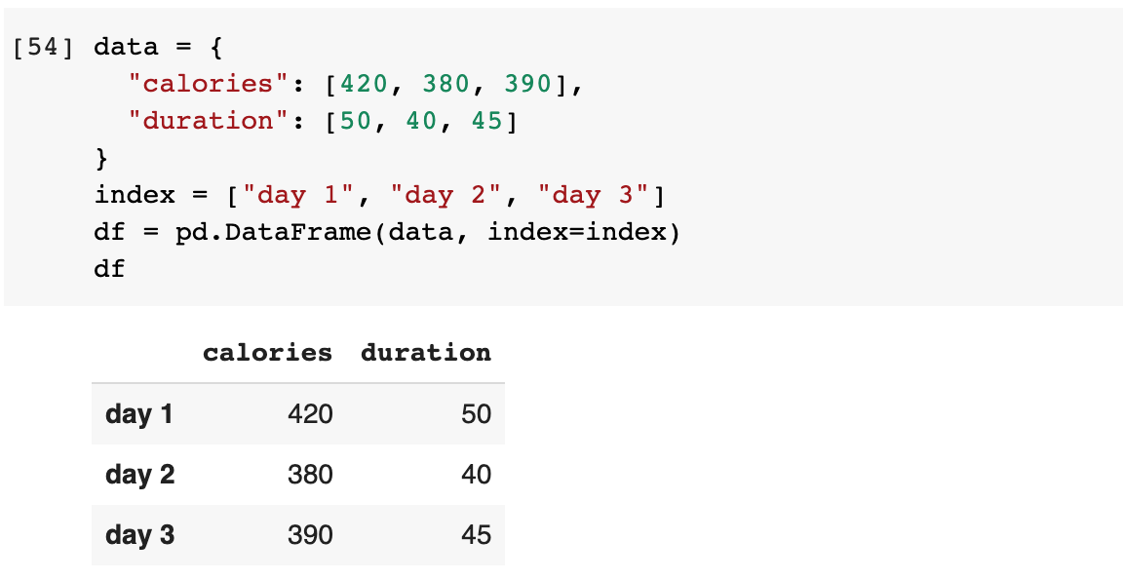
Pandas
DataFrame
Indexing

Slide 25
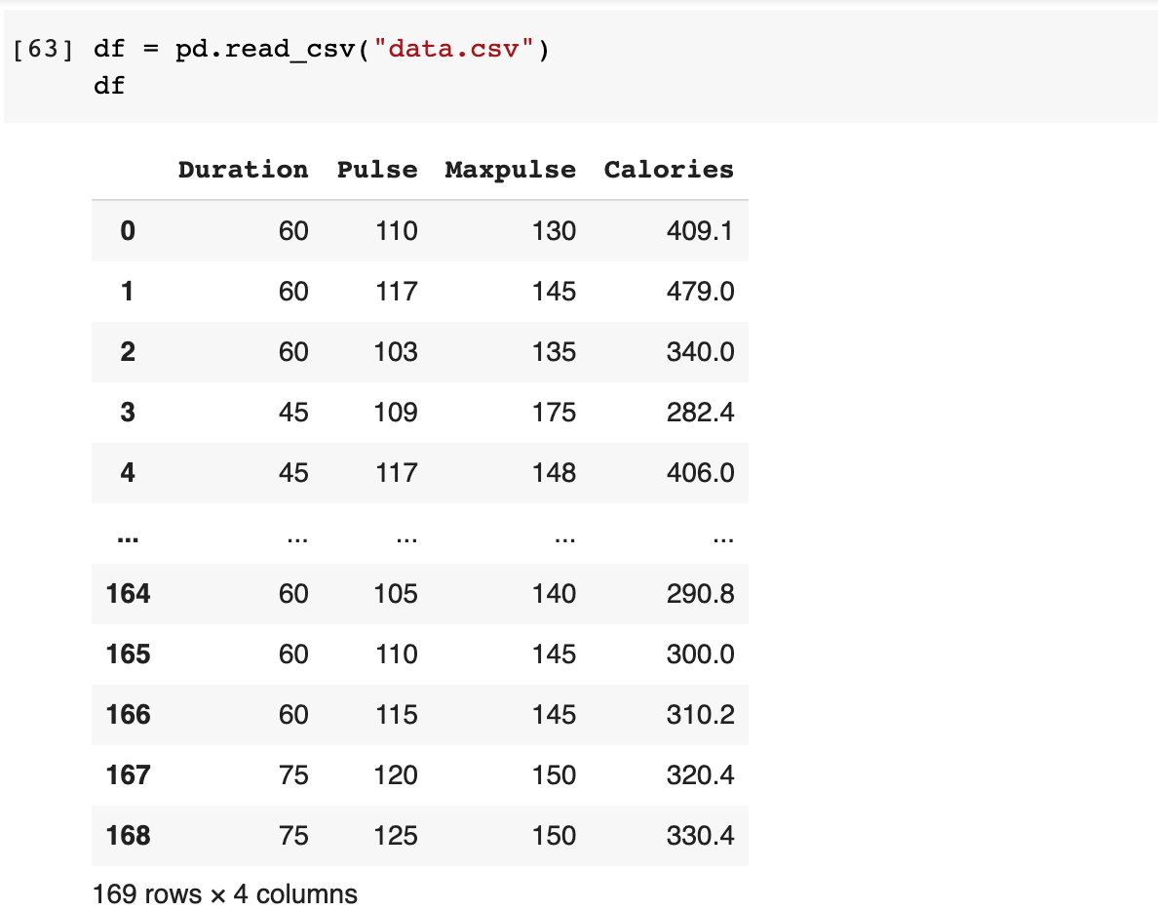
Reading from CSV
Load CSV file to Pandas DataFrame

Slide 26
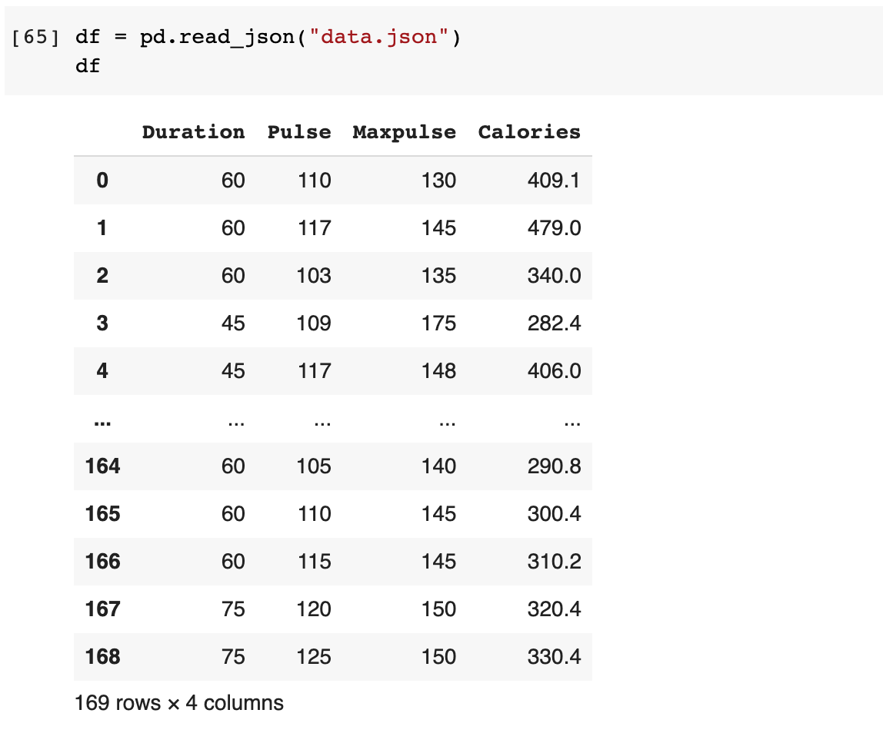
Reading from JSON
Load JSON file to Pandas DataFrame

Slide 27
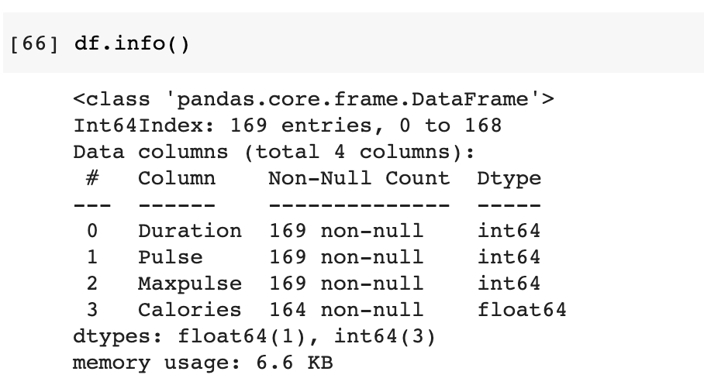
Getting DataFrame Info
Getting columns, non-null data, and data types

Slide 28
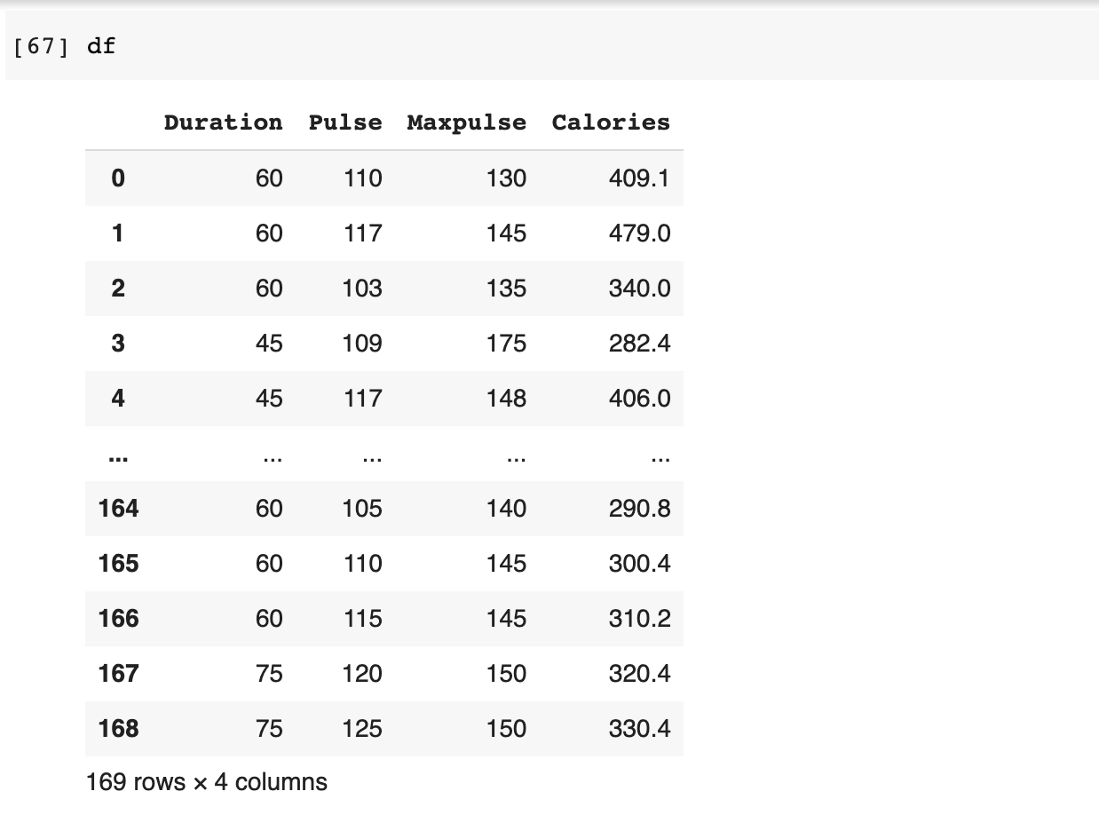
Displaying DataFrame
Show compact DataFrame

Slide 29
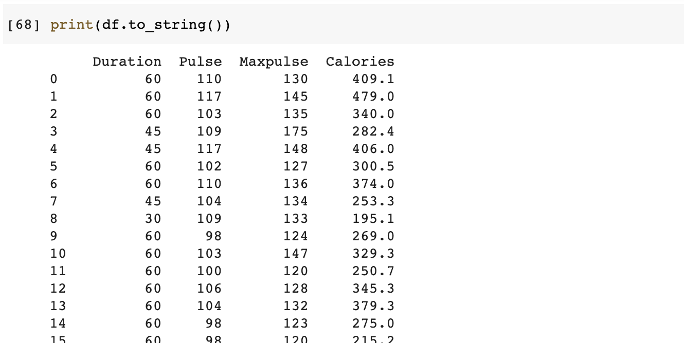
Displaying DataFrame
Show full DataFrame

Slide 30
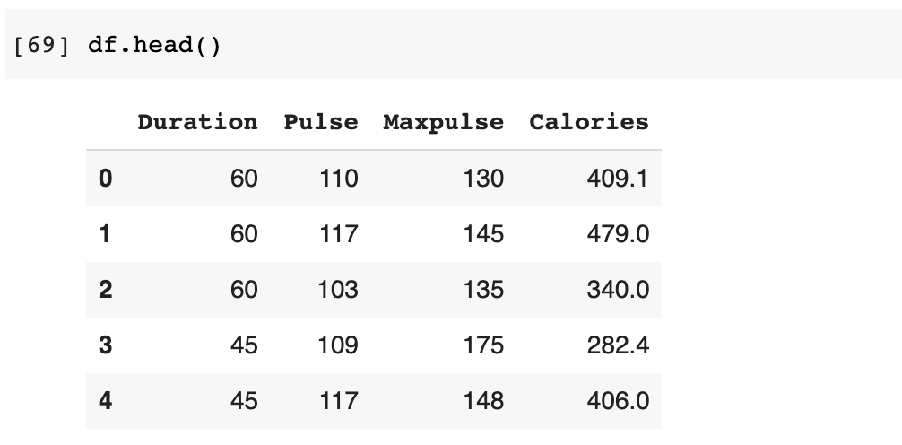
Displaying DataFrame
Show first 5 entries

Slide 31
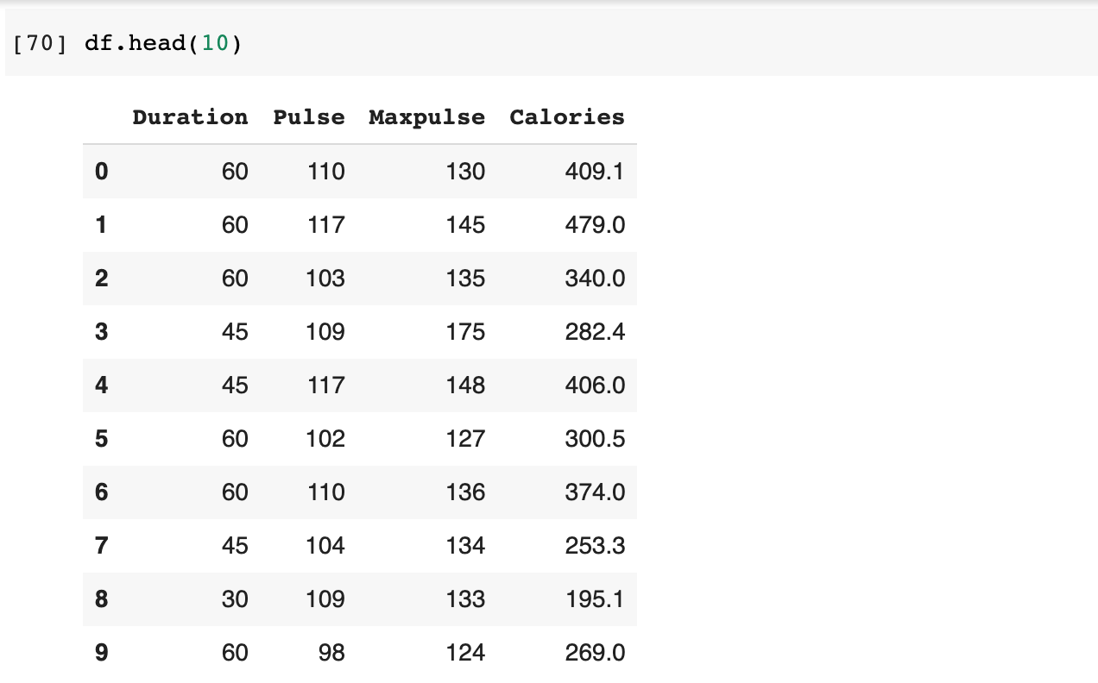
Displaying DataFrame
Show first 10 entries

Slide 32
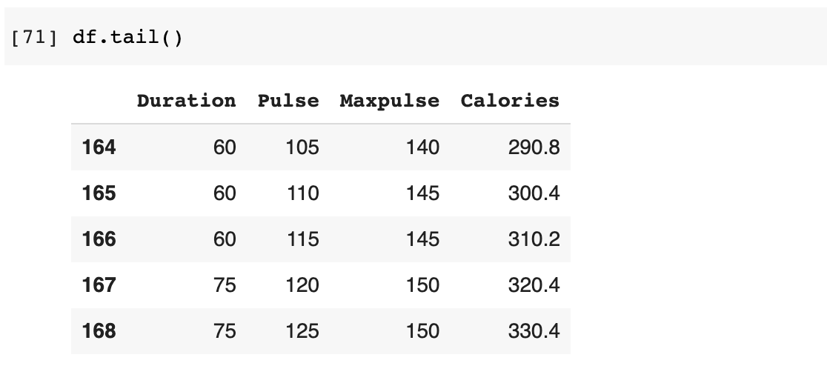
Displaying DataFrame
Show last 5 entries

Slide 33
Data Cleaning
Data cleaning or cleansing is the process of detecting and correcting (or removing) corrupt or inaccurate records from a record set, table, or database and refers to identifying incomplete, incorrect, inaccurate or irrelevant parts of the data and then replacing, modifying, or deleting the dirty or coarse data.

Slide 34
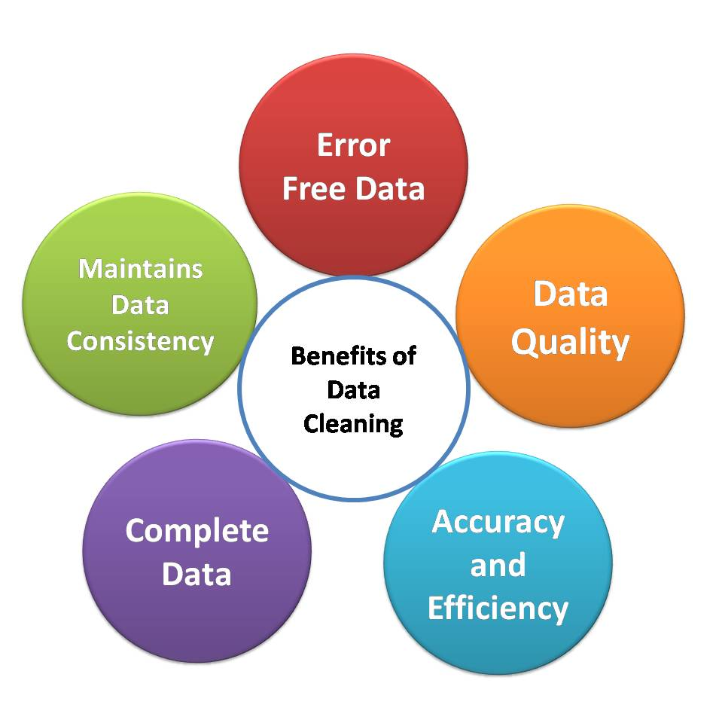
Why clean data?

Slide 35
Forms of Bad Data
Empty cells
Data in wrong format
Wrong data
Duplicate entries

Slide 36
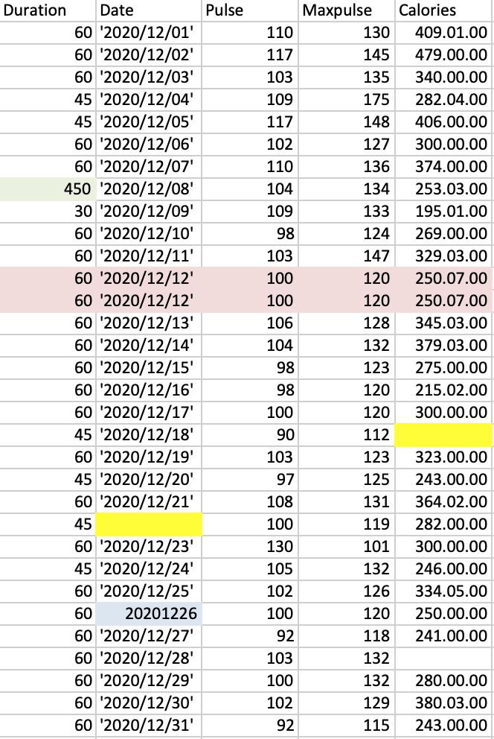
dirtydata.csv
Sample data

Slide 37
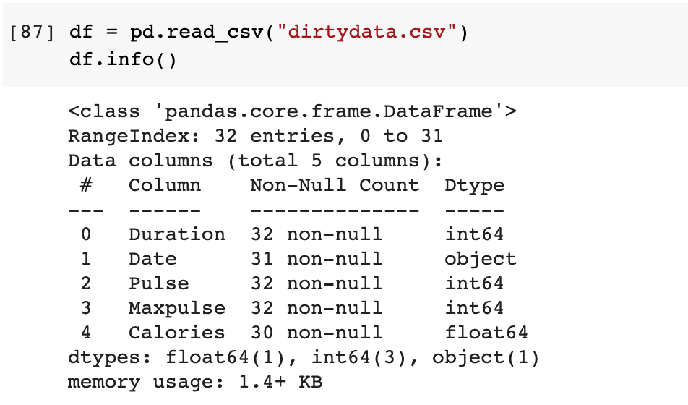
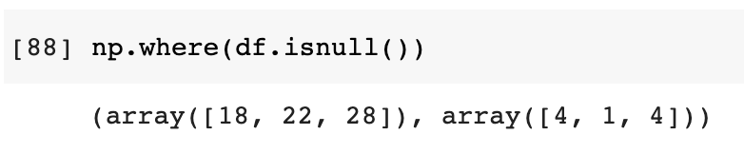
Dealing with Empty Cells
First step: checking for empty values

Slide 38
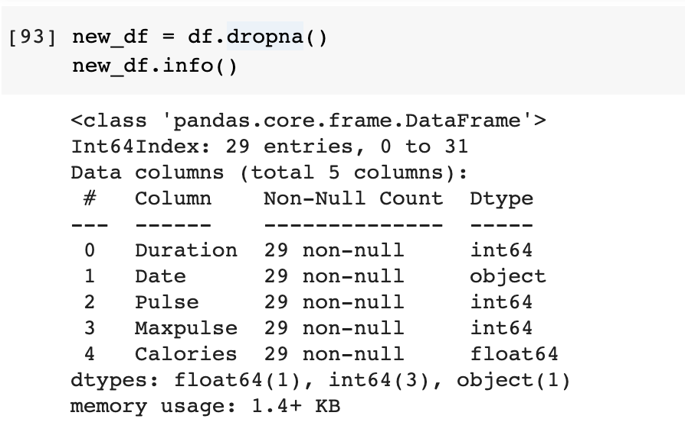
Dealing with Empty Cells
Alternative: remove entries with empty values

Slide 39
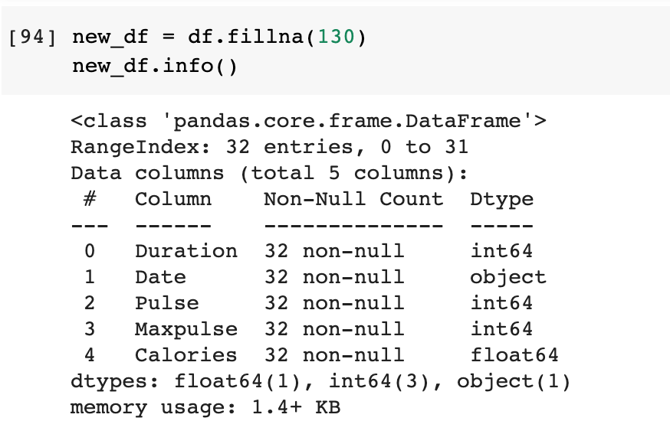
Dealing with Empty Cells
Alternative: replace empty values with specified value

Slide 40
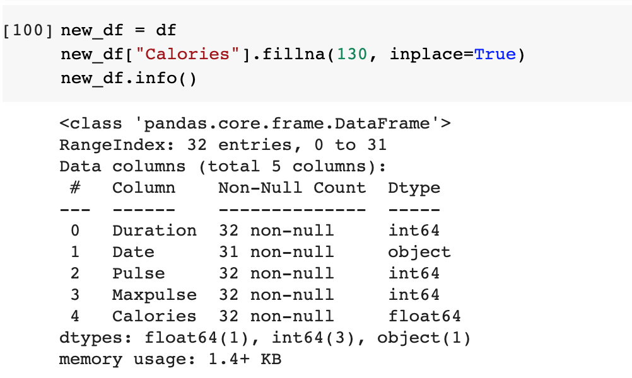
Dealing with Empty Cells
Alternative: replace empty values with specified value on specified column

Slide 41
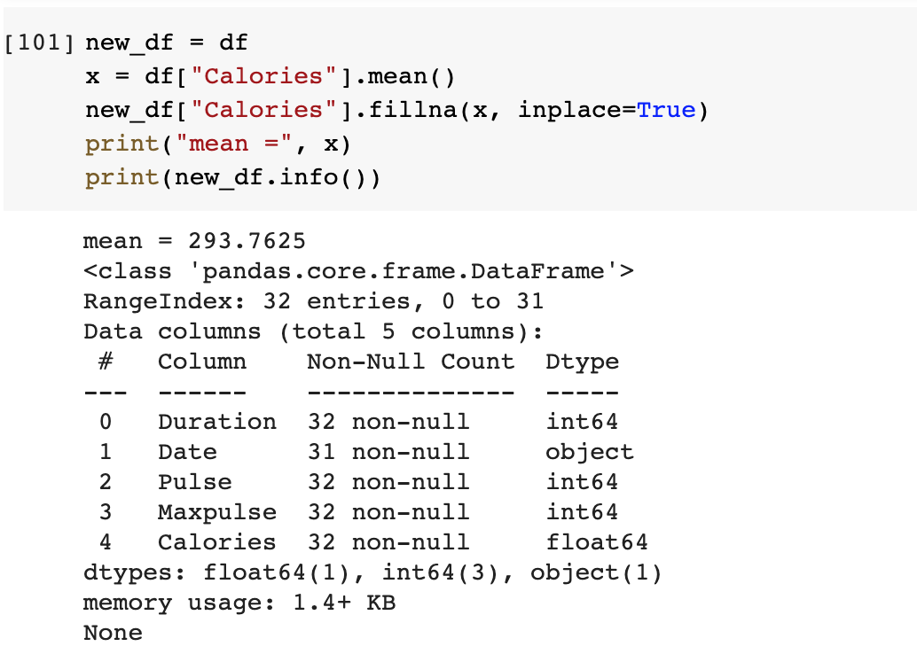
Dealing with Empty Cells
Alternative: replace empty values with mean

Slide 42
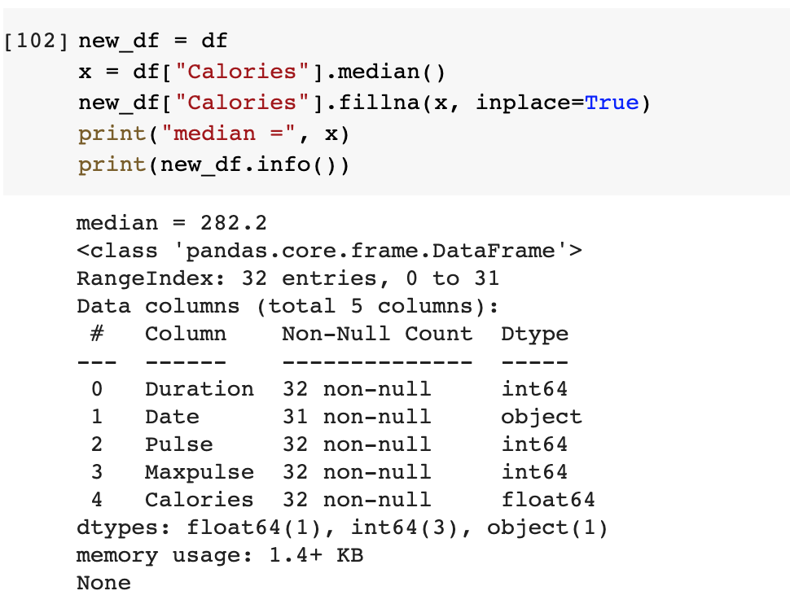
Dealing with Empty Cells
Alternative: replace empty values with median

Slide 43
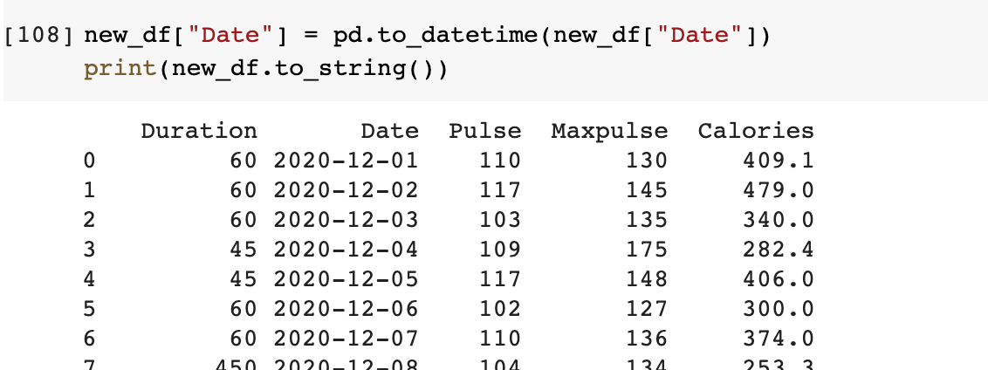
Dealing with Wrong Format
Alternative: convert to the same format

Slide 44
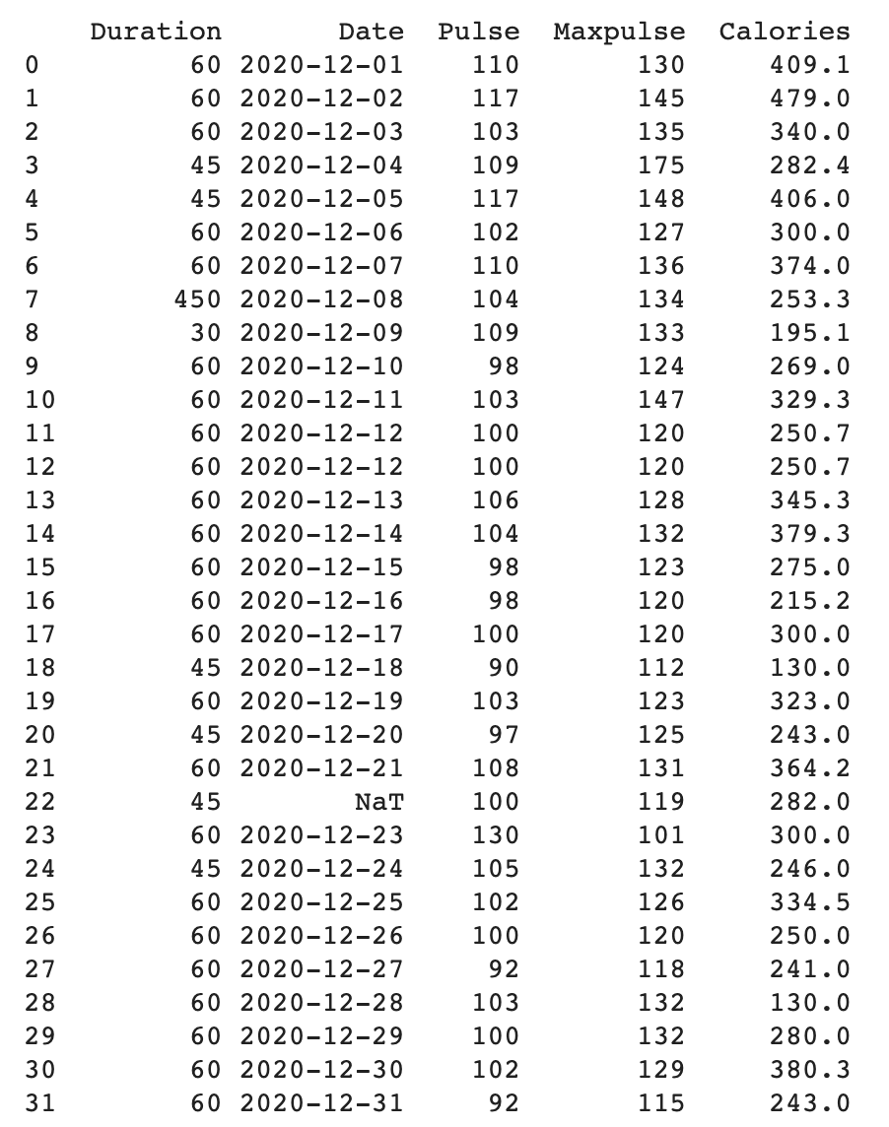
Full output

Slide 45
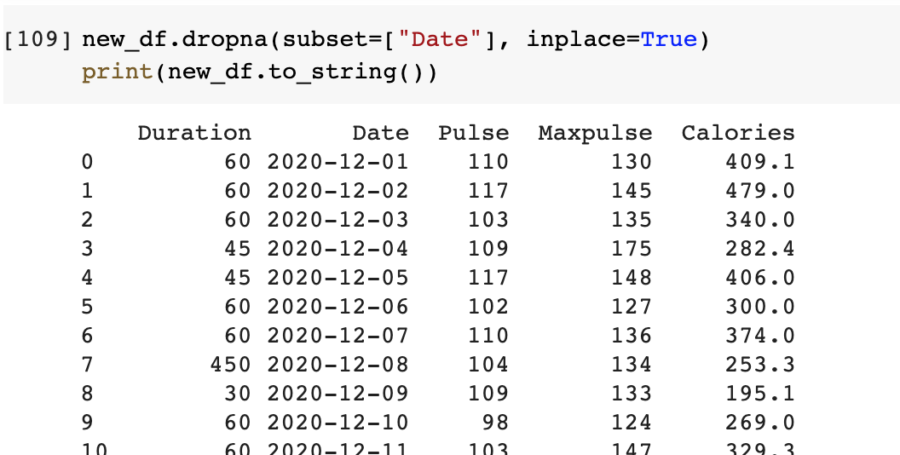
Dealing with Wrong Format
Alternative: remove rows with wrong format

Slide 46
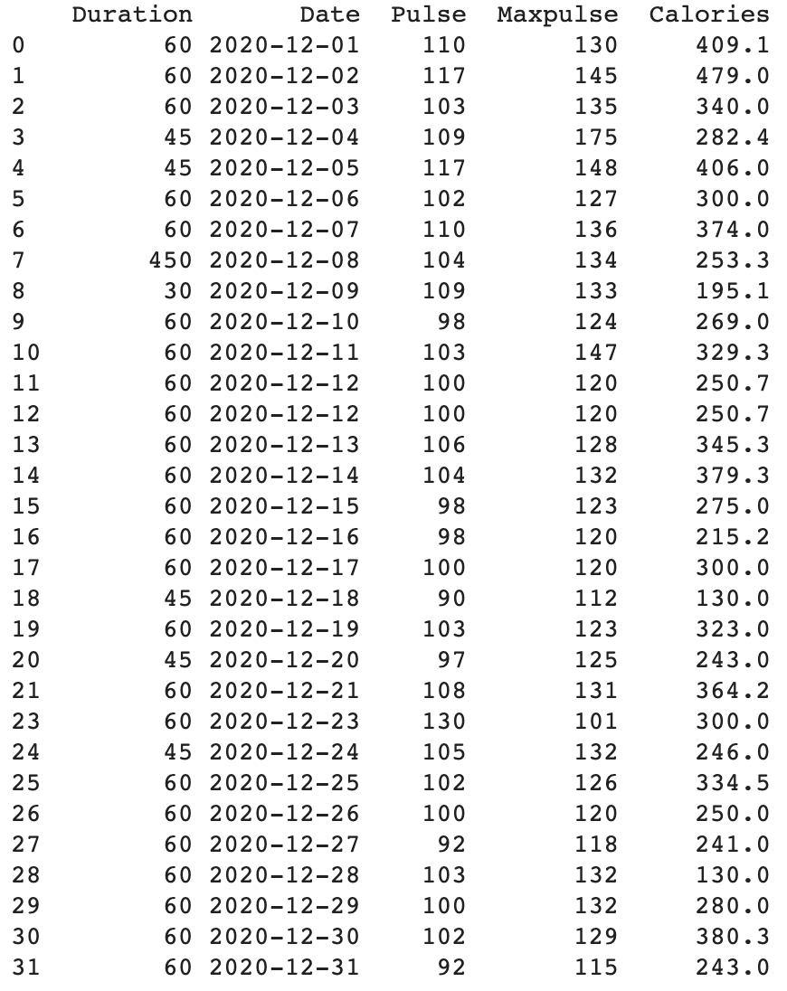
Full output

Slide 47
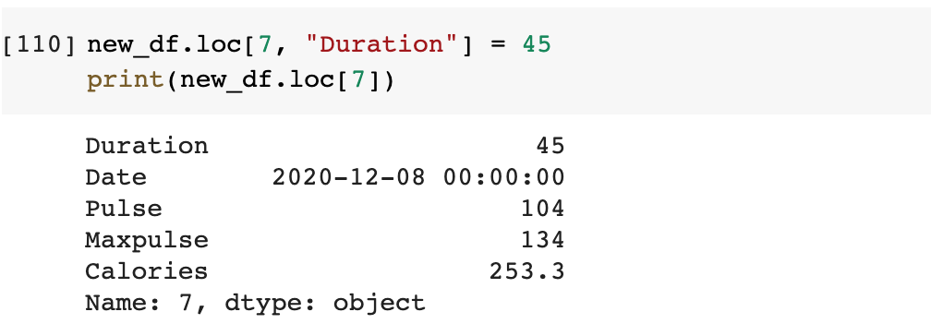
Dealing with Wrong Data
Alternative: replace value with the correct data

Slide 48
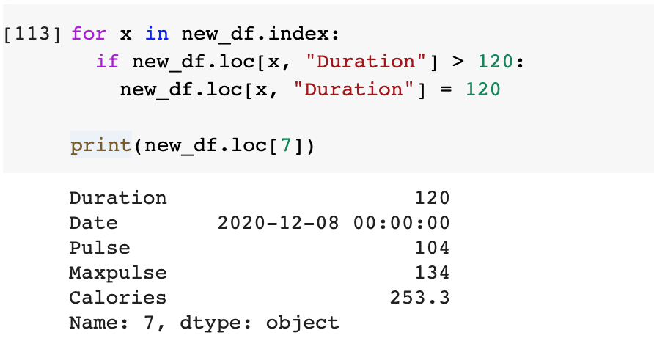
Dealing with Wrong Data
Alternative: set a boundary and replace out of bounds values

Slide 49
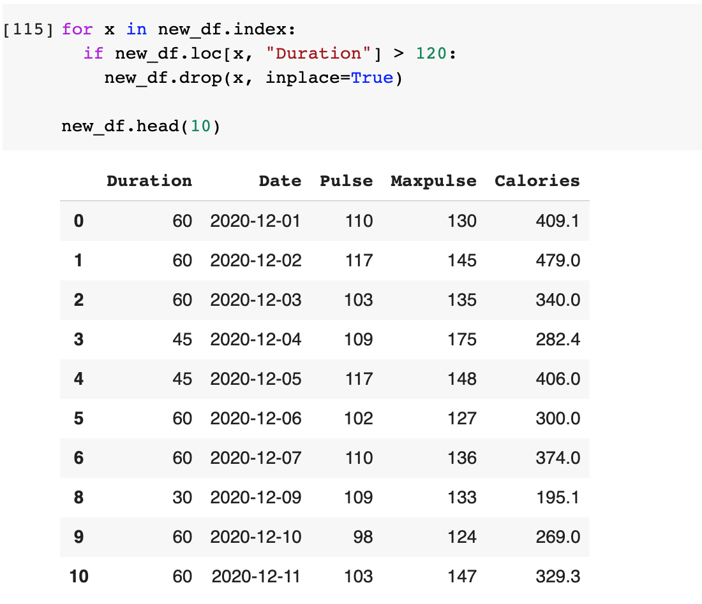
Dealing with Wrong Data
Alternative: set a boundary and remove rows with out of bounds values

Slide 50
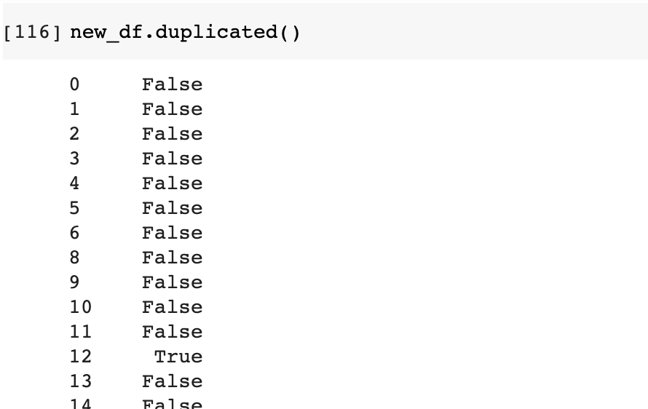
Dealing with Duplicate Entries
First step: Check for duplicate entries

Slide 51
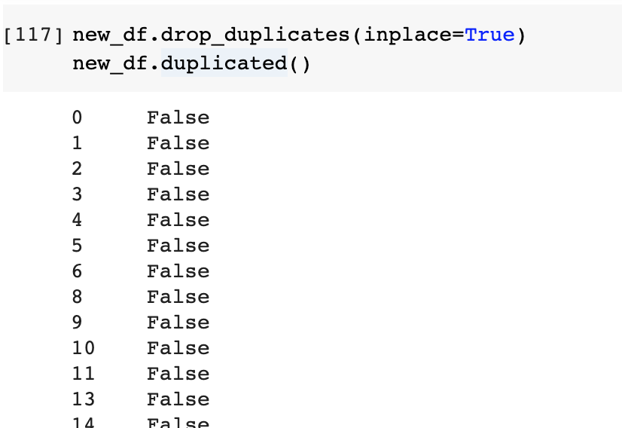
Dealing with Duplicate Entries
Remove duplicated row

Slide 52
Reset Index
Notice that when we remove rows, the indices are also dropped and we end up with missing indices.
A good practice is to reset index everytime we drop rows (if there’s no need to keep track of dropped rows).

Slide 53
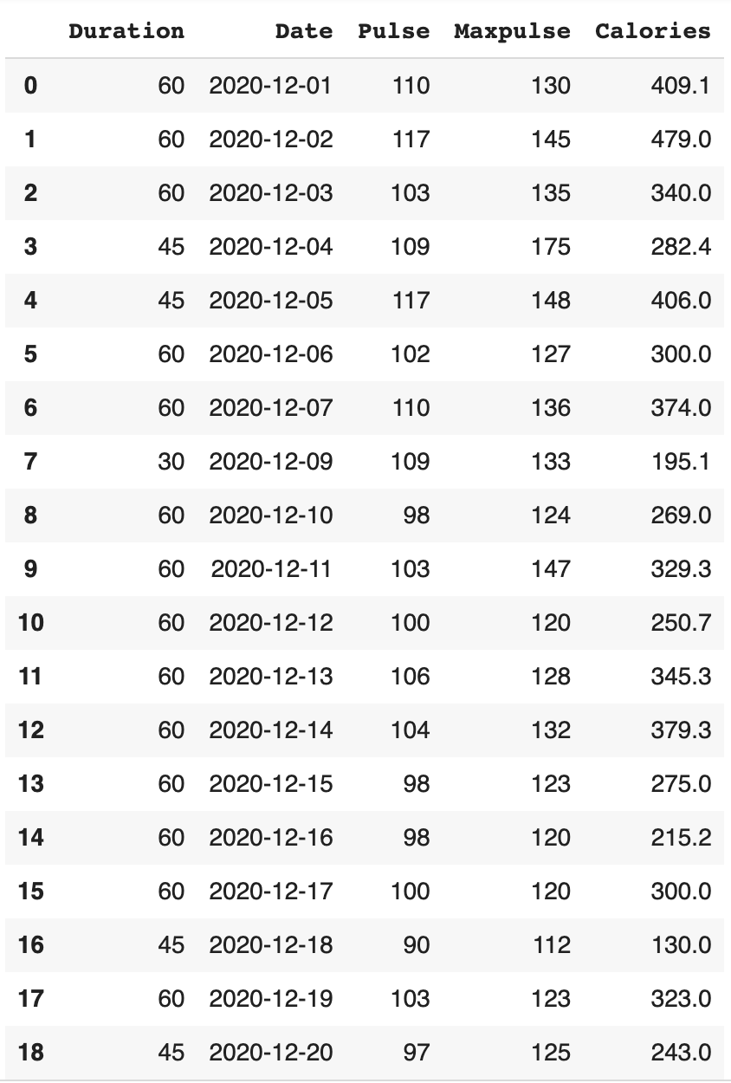
Partial output*
*enough to see that reset_index() worked

Slide 54
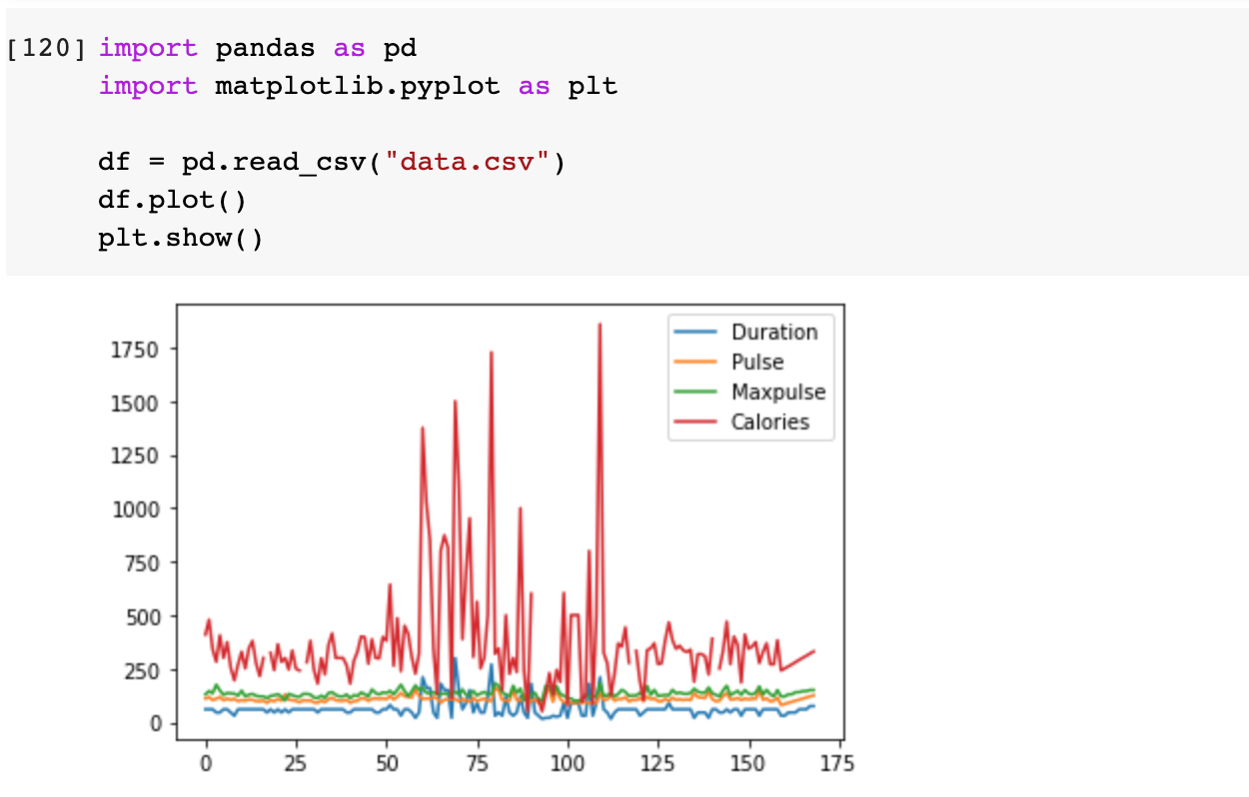
Plotting with matplotlib.pyplot
Import necessary modules.
Load file to DataFrame and use plot, then call plt.show() to display it.

Slide 55
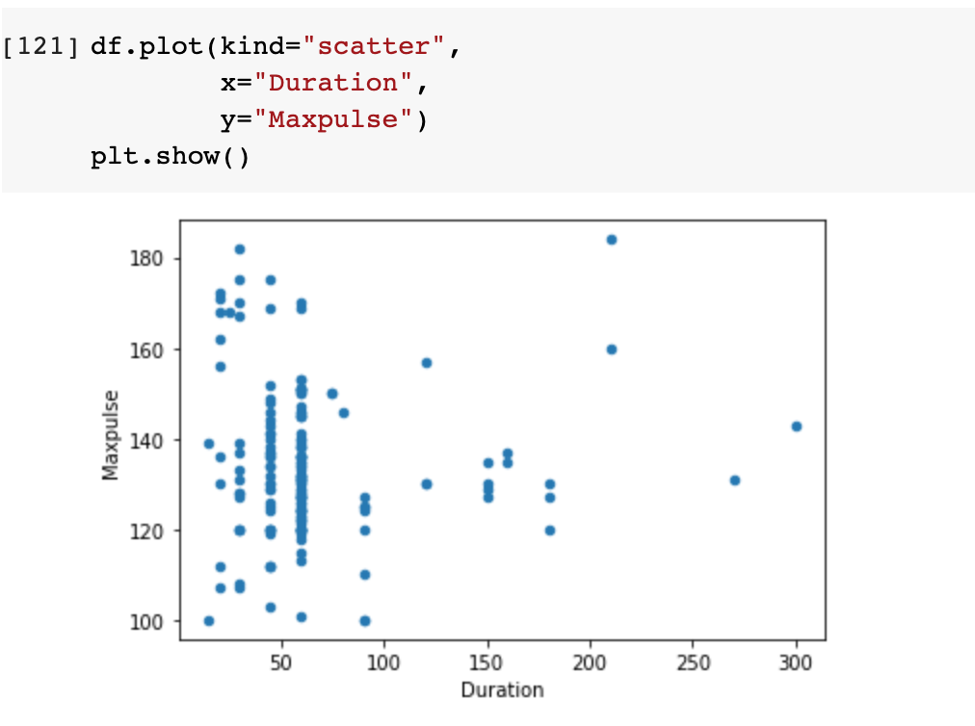
Scatter Plot
Plot Maxpulse against Duration

Slide 56
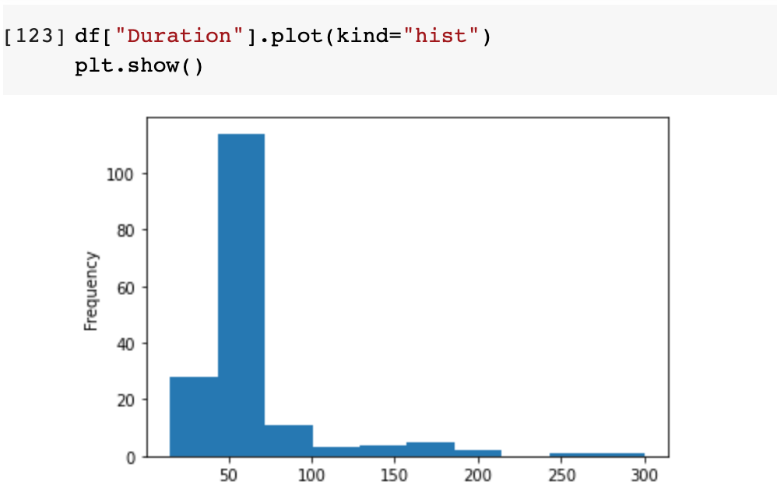
Histogram
Plot the frequency of Duration

Slide 57
Exploratory Data Analysis (EDA)

Slide 58
EDA
“In statistics, exploratory data analysis is an approach to analyzing data sets to summarize their main characteristics, often with visual methods. A statistical model can be used or not, but primarily EDA is for seeing what the data can tell us beyond the formal modeling or hypothesis testing task.”
Uses data visualization to draw meaningful patterns and insights.
Involves the preparation of data sets for analysis by removing irregularities in the data.
General steps:
Data sourcing
Data cleaning
Data visualization
Data correlation

Slide 59
References
https://www.w3schools.com/python/pandas/default.asp
https://numpy.org/doc/stable/user/quickstart.html
https://towardsdatascience.com/exploratory-data-analysis-eda-python-87178e35b14
https://www.youtube.com/watch?v=a9UrKTVEeZA
https://www.youtube.com/watch?v=GPVsHOlRBBI

Slide 60
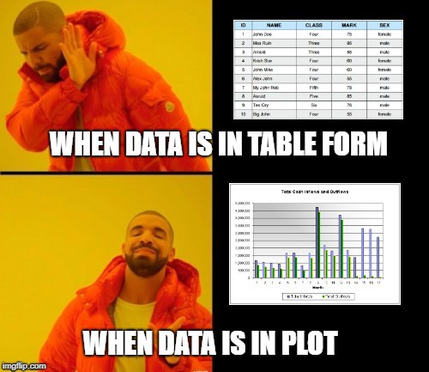



Thank You!

